Slide 1
C.S. Lewis
“There is, to be sure, one glaringly obvious ground for denying that any moral purpose at all is operative in the universe: namely, the actual course of events in all its wasteful cruelty and apparent indifference, or hostility, to life.”

Slide 2
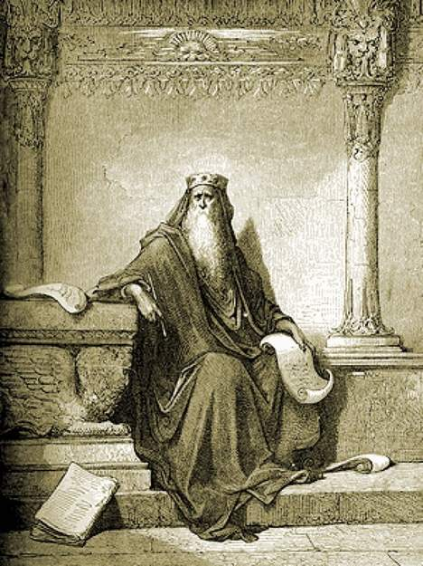
Ecclesiastes engraving. Author: Gustave Dor (1832-1883)

Slide 3
Who was Solomon’s audience?
Rejoice, O young man, in your youth, and let your heart cheer you in the days of your youth. Walk in the ways of your heart and the sight of your eyes. But know that for all these things God will bring you into judgment. ¹⁰ Remove vexation from your heart, and put away pain from your body, for youth and the dawn of life are vanity. (Ecc 11:9-10 ESV)
Remember also your Creator in the days of your youth, before the evil days come and the years draw near of which you will say, "I have no pleasure in them"; (Ecc 12:1 ESV)

Slide 4
Key Word Example
“Find” which has the nuance, “to find by research. And a recurring theme in the book is the impossibility of “finding out the meaning of it all” by research (3:11; 7:14, 24; 8:17

Slide 5
¹⁷ then I saw all the work of God, that man cannot find out the work that is done under the sun. However much man may toil in seeking, he will not find it out. Even though a wise man claims to know, he cannot find it out. (Ecclesiastes 8:17 ESV)

Slide 6
¹¹ He has made everything beautiful in its time. Also, he has put eternity into man's heart, yet so that he cannot find out what God has done from the beginning to the end. (Ecc 3:11 ESV)

Slide 7
¹⁴ In the day of prosperity be joyful, and in the day of adversity consider: God has made the one as well as the other, so that man may not find out anything that will be after him. (Ecc 7:14 ESV)

Slide 8
We can’t get above the line, yet God can reveal things to us if he chooses.

Slide 9
As you do not know the way the spirit comes to the bones in the womb of a woman with child, so you do not know the work of God who makes everything. (Ecc 11:5 ESV)

Slide 10
Summary of the Overall Meaning of Ecclesiastes
“Understanding it all is not a precondition for faithful obedience”
Dr. C. John Collins

Slide 11
Wisdom in Light of Our Limits
¹² I perceived that there is nothing better for them than to be joyful and to do good as long as they live; ¹³ also that everyone should eat and drink and take pleasure in all his toil--this is God's gift to man. (Ecclesiastes 3:12-13 ESV)
¹⁷ I said in my heart, God will judge the righteous and the wicked, for there is a time for every matter and for every work. (Ecclesiastes 3:17 ESV)

Slide 12
Wisdom in Light of Our Limits
Go, eat your bread with joy, and drink your wine with a merry heart, for God has already approved what you do. ⁸ Let your garments be always white. Let not oil be lacking on your head. ⁹ Enjoy life with the wife whom you love, all the days of your vain life that he has given you under the sun, because that is your portion in life and in your toil at which you toil under the sun.¹⁰ Whatever your hand finds to do, do it with your might… (Ecc 9:7-10 ESV)

Slide 13
Wisdom in Light of Our Limits
¹³ The end of the matter; all has been heard. Fear God and keep his commandments, for this is the whole duty of man. ¹⁴ For God will bring every deed into judgment, with every secret thing, whether good or evil. (Ecc 12:13-14 ESV)

Slide 15
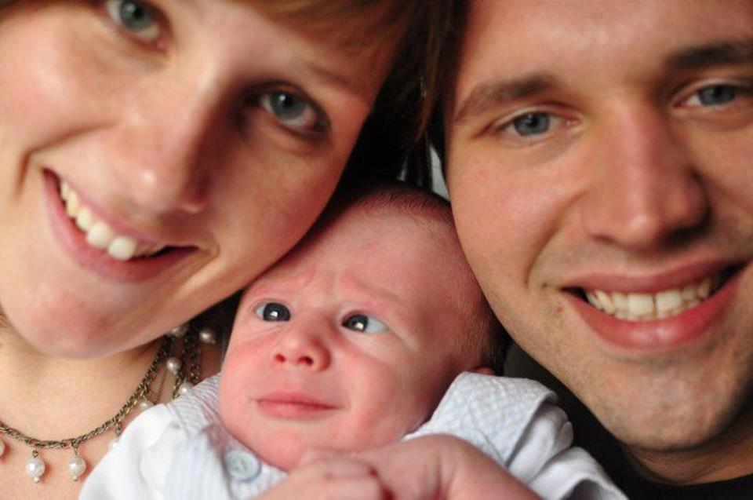
Sometimes we have trouble trusting…

Slide 16
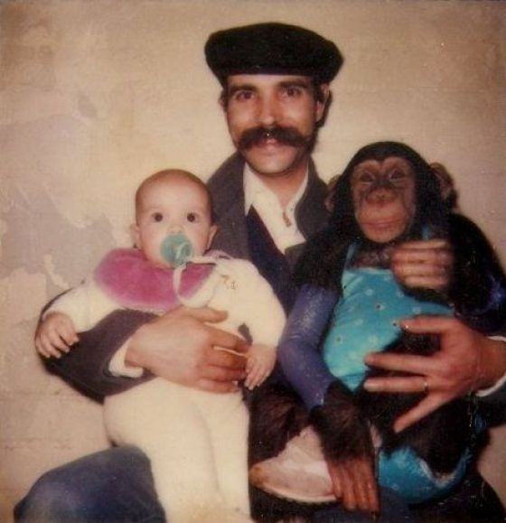
Some parents might be less worthy of our trust than others…

Slide 17
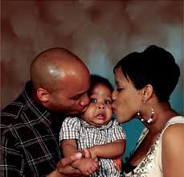
We don’t always understand what’s going on, even though we are loved.

Slide 18
Why can we trust this God?
He is the God who made the “wondrously complex world order.”
Who accomplished the great redemption from Egypt.
Who later accomplished an even greater redemption from sin and Satan through Christ.
So we know that all he does is well, even if for the moment he hides his hand.

Slide 19
Song of Songs
⁶ Set me as a seal upon your heart, as a seal upon your arm, for love is strong as death, jealousy is fierce as the grave. Its flashes are flashes of fire, the very flame of the LORD. ⁷ Many waters cannot quench love, neither can floods drown it. If a man offered for love all the wealth of his house, he would be utterly despised. (Song of Songs 8:6-7 ESV)

Slide 20
Interpretation of Song of Songs
“The Song of Solomon has in fact been subject to a broader range of interpretation probably than any other book in the Bible.”
ESV Study Bible, 1211

Slide 21
Dream Interpretation
Coherence:
one follows a single love story from initial longing right through to the marital enjoyment
The characters have consistent patterns in how they speak to and about one another.

Slide 22
Dream Interpretation
Characters:
Young woman
The shepherd whom she loves
King Solomon
Chorus-like group

Slide 23
Dream Interpretation
Consummation:
3:1-6:3 is a dream in anticipation of the marriage and its consummation. Therefore on this understanding 5:2-8 is part of the dream (“I slept, but my heart was awake,” 5:2) and chapter 7 is an eager anticipation of the enjoyment the couple will have once they are married (in ch. 8).
The fact that Song of Songs is in the canon of Scripture and the fact that this view harmonizes with Proverbs 5:15-19 in commending sexual delight within marriage, lends further support to the conclusion that consummation occurs only after the couple is married
Occurs in 8:5: contrast the shepherd being “awakened under the apple tree” with the refrain to not “stir up or awaken love until it pleases”
ESV Study Bible, 1212

Slide 24
Allegorical Interpretation
Extended picture of the love between Israel’s God and his people, and then between Christ and his bride (either the church or the individual soul).
Limitation: it runs the risk of diminishing the wisdom character of the song and it’s endorsement of God’s good work of creation as evidenced in marital love.
ESV Study Bible, 1214

Slide 25
Anthology Interpretation
The Song is really a collection of multiple songs, an anthology or collection. They are a celebration of the intimate love between a man and a woman – a celebration of love’s longing, ecstasy, joy, beauty, and exclusivity.
Limitation: it rejects the idea that the book contains a narrative plot.
ESV Study Bible 1214

Slide 26
The Shepherd Hypothesis
Young woman and shepherd boy are two simple country folk in love, and King Solomon seeks to win the woman’s consent to become part of his harem.
The woman resists all his flattery and returns home to marry the shepherd.
Limitation: It does supply any way for the reader to know when the shepherd speaks and when Solomon does. Also, why would the book be dedicated to Solomon if he was the intruder in the story who was rejected?
ESV Study Bible 1214

