Slide 1
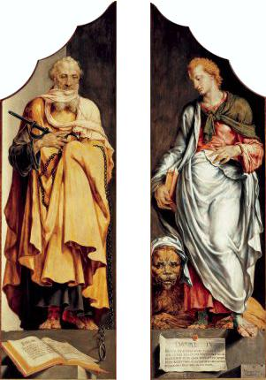
The Prophets Ezekiel and Daniel Maerten Van Heemskerck, 1560

Slide 2
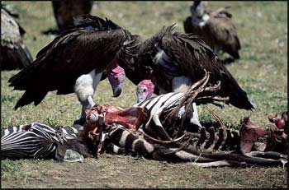
EXILE

Slide 3
Story of Exile
Assyria
Babylon (gained control after fall of Assyria in 612 BC)
Nebuchadnezzar (605-562 BC)
Jehoiachin taken prisoner to Babylon
Zedekiah (Jerusalem destroyed)
Exile
First Deportation – 605 BC
Leading citizens and nobility are brought to Babylon, including Daniel and his three friends
Second Deportation – 597 BC
Jehoiachin and Ezekiel
Third Deportation – 587/6 BC
Zedekiah
We shouldn’t think that the LORD has been quick to cast his people out of the land. On the contrary, God is portrayed throughout the OT as moving slowly and regretfully toward this judgment…God’s pain is evident when he cries out through Hosea, ‘How can I give you up, Ephraim? How can I hand you over, Israel?’ (Hosea 11:8). The OT prophets bear ample witness to God’s patience with his people and to the repeated efforts he makes to call them back to faithfulness within the covenant.” Bartholomew and Goheen.

Slide 4
Biblical Theology: Creation, Exile and the 4 P’s
Describe the 4 P’s at creation. Describe them at the Exile? What are the similarities and differences?
The 4 P’s are:
Presence
Place
People
Purpose

Slide 5
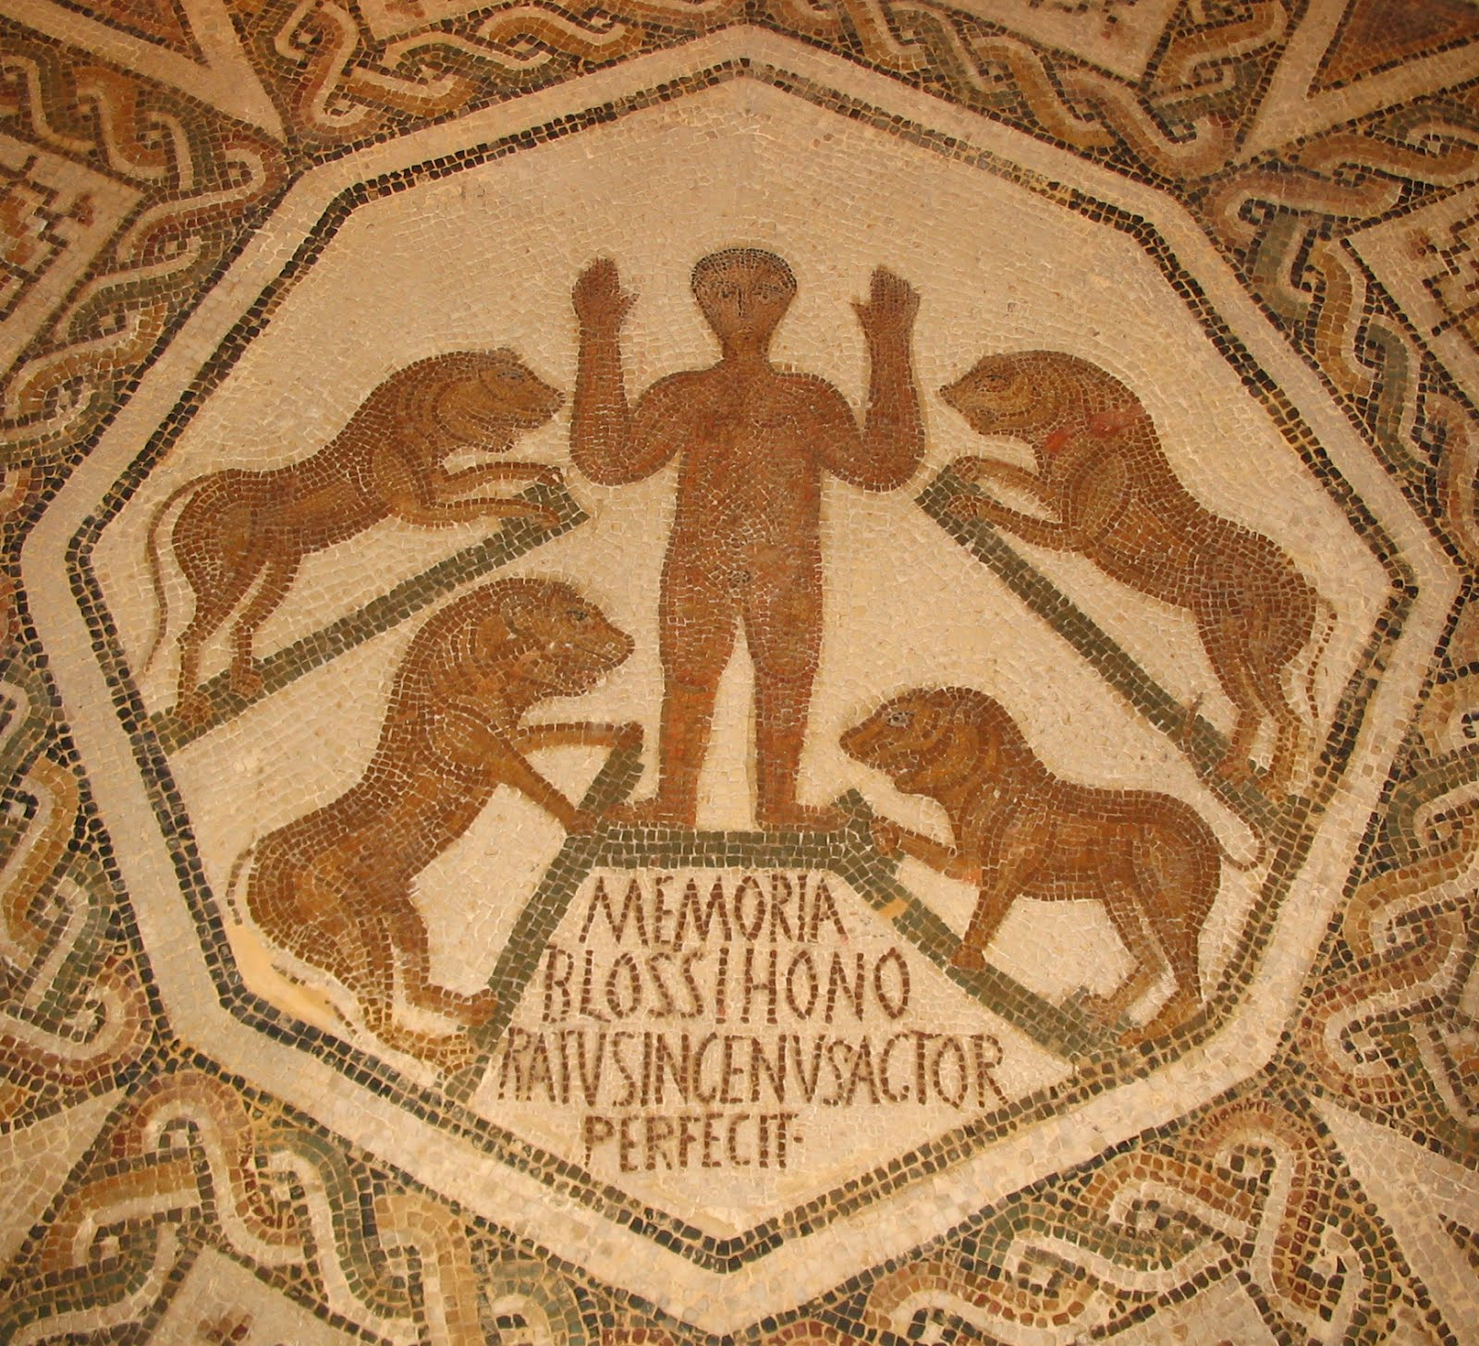
Daniel in Lions Den Tunisia, 5th Century

Slide 6
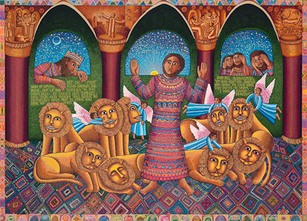
Daniel in the Lions Den John August Swanson, 2000

Slide 7
Chapter 2 | Chapter 7 | Chapter 8 | Interpretation
Head of Gold | Lion |  | Babylon deported Judah’s king in 605
Chest and Arms of Silver | Bear | Ram | Medo-Persian Empire defeated Babylon in 539 BC
Belly and Thighs of Bronze | Leopard | Goat (North/South in chapter 11) | Greece defeats Persians in 331 BC Prolemies and Seleucids
Legs of Iron | Terrifying Beast |  | Rome assimilated former Greek holdings
Rock Against Feet of Clay | Son of Man |  | Kingdom of God

Slide 8
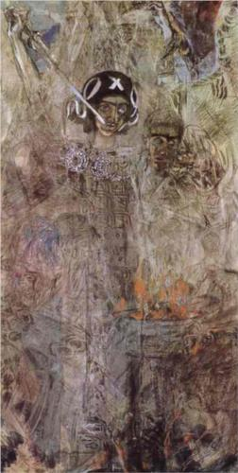
The Vision of the Prophet Ezekiel Mikhail Vrubel, 1906

Slide 9
Ezekiel – Prophet in Exile
In Babylon while Zedekiah is on throne in Judah (Ezekiel 1-24)
Priestly heritage informs both his prophecies and the language he employs in his oracles.” Kaminski
Central Theme: Knowledge of the divine PRESENCE
Vision of LORD’s glory
Great agony at LORD’s departure
Deepest hope in LORD’s return
The LORD always acts to uphold his glory and make it known (either in grace or judgment)
“Then they will know that I am the LORD”

Slide 10
PRESENCE of God Think, Pair and Share
How is the presence of God good for people? What is God’s presence like? When is God present? When is he not? What other passages come to mind?
First Exodus 33:15-16 Exodus 40:33-48 | Second 1 Kings 6:12-13 1 Kings 8:10-16 | Third Ezekiel 1:4-28 Ezekiel 11:22-23 | Fourth Ezekiel 43:1-7

Slide 11
Ezekiel 5:5-9 and God’s Mission
⁵ "Thus says the Lord GOD: This is Jerusalem. I have set her in the center of the nations, with countries all around her. ⁶ And she has rebelled against my rules by doing wickedness more than the nations, and against my statutes more than the countries all around her; for they have rejected my rules and have not walked in my statutes. ⁷ Therefore thus says the Lord GOD: Because you are more turbulent than the nations that are all around you, and have not walked in my statutes or obeyed my rules, and have not even acted according to the rules of the nations that are all around you, ⁸ therefore thus says the Lord GOD: Behold, I, even I, am against you. And I will execute judgments in your midst in the sight of the nations. ⁹ And because of all your abominations I will do with you what I have never yet done, and the like of which I will never do again.”
Compare with Deuteronomy 4:1-8

Slide 12
Life in Babylon
“We do not know a great deal about the life of the Israelites while they were in exile. Certainly their situation in Babylon must have been far from pleasant – but there were worse conquerors than the Babylonians. The Israelites were at least able to be part of the Babylonian Empire while remaining in their own communities and holding on to some of their cultural and religioius distintinctiveness. Nevertheless, two Old Testament narratives, the books of Daniel and Esther, deal with the conflicts of loyalty that could arise for committed Israelites while in exile.” Bartholomew and Goheen

