Slide 1
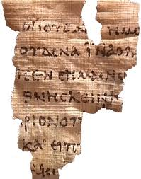
The Gospel according to John
John Rylands Manuscript
c. 125-140

Slide 2
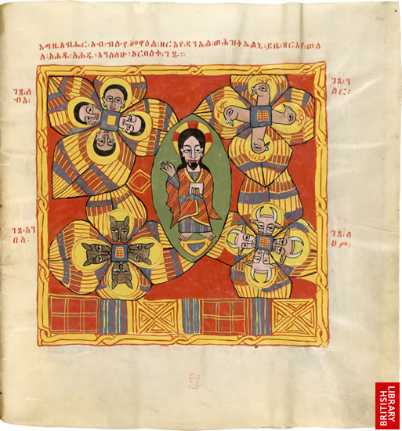
The Four Authoritative Gospels The Glory of the Lord Ethiopic Bible, 17th Century

Slide 3
The Act of Communication
Author
Text
Message
Shared World
Language Used
Things Accustomed To
Worldview
Our World

Slide 4
4 P’s of the Bible
Presence
Place
Purpose
People

Slide 5
Modern Day Jerusalem

Slide 6
Site of Crucifixion

Slide 7
Same building, different denomination
Different groups memorialize the site differently. A testimony to our diversity in unity.

Slide 8
First Century Graves at Site of Resurrection

Slide 10
The Act of Communication
Author
Text
Message
Shared World
Language Used
Things Accustomed To
Worldview
Our World

Slide 11
John’s Prologue
Survey
Observe
What words, phrases or themes in this passage does John use elsewhere?
Analyze
What questions were being addressed that may bring up theses topics?
How does John address these questions, issues, and problems?
Respond
What are similar topics we need to address today?
How does our American culture address them?
How have churches addressed them?

Slide 12
Themes in John’s Prologue
Life
World
Light
Receive
Believe
Glory
Truth
Law (through Moses)
Word
Pre-existence
Creation
Rejection of the Word
His own people
Children of God
Born of God
Word became flesh
Glory of the Son
Only Son
Grace (not mentioned though concept is evident)
Fullness (not mentioned though concept is evident)
Revealer of the Father
Witness of John the Baptist

