Slide 1
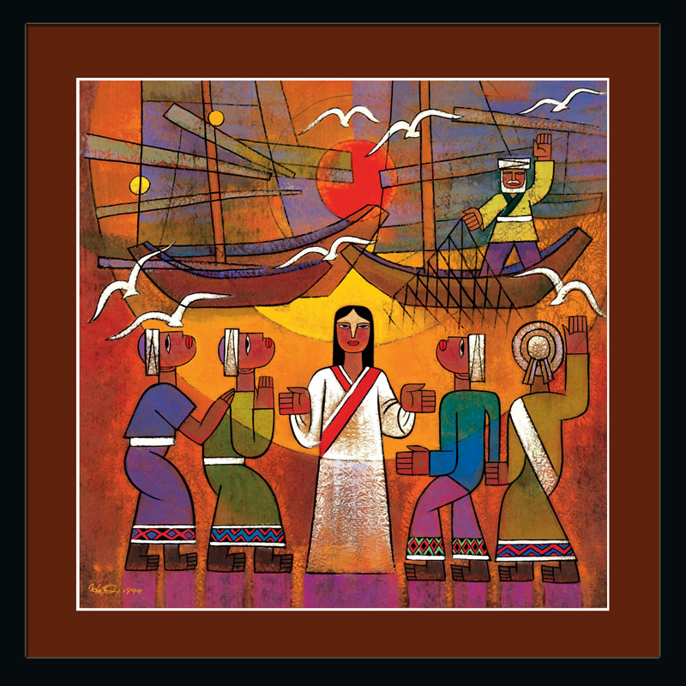
The Gospel of Mark He Qi, www.heqigallery.com

Slide 2
A
S
K
E
T
E
M
P
T
Y
C

Slide 3
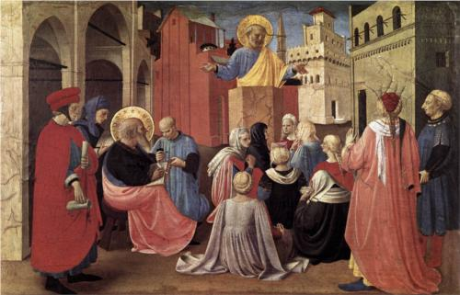
St. Peter Preaching in the Presence of Saint Mark Fra Angelico, c. 1433

Slide 4
Peter’s House
1. the house was built in the Late Hellenistic period; 2. in the late first century A.D. it was changed into a "domus-ecclesia", i. e. became a house for religious gatherings; 3. in the fourth century A.D. the same "domus-ecclesia" was enlarged and was set apart from the rest of the town through an imposing enclosure wall; 4. in the second half of the fifth century A.D. an octagonal church was built upon the house of St. Peter and remained in use until the seventh century A.D.; 5. the identification of the house of St. Peter is based on the combination of archaeological data and literary sources which run side by side in a wonderful way.

Slide 6
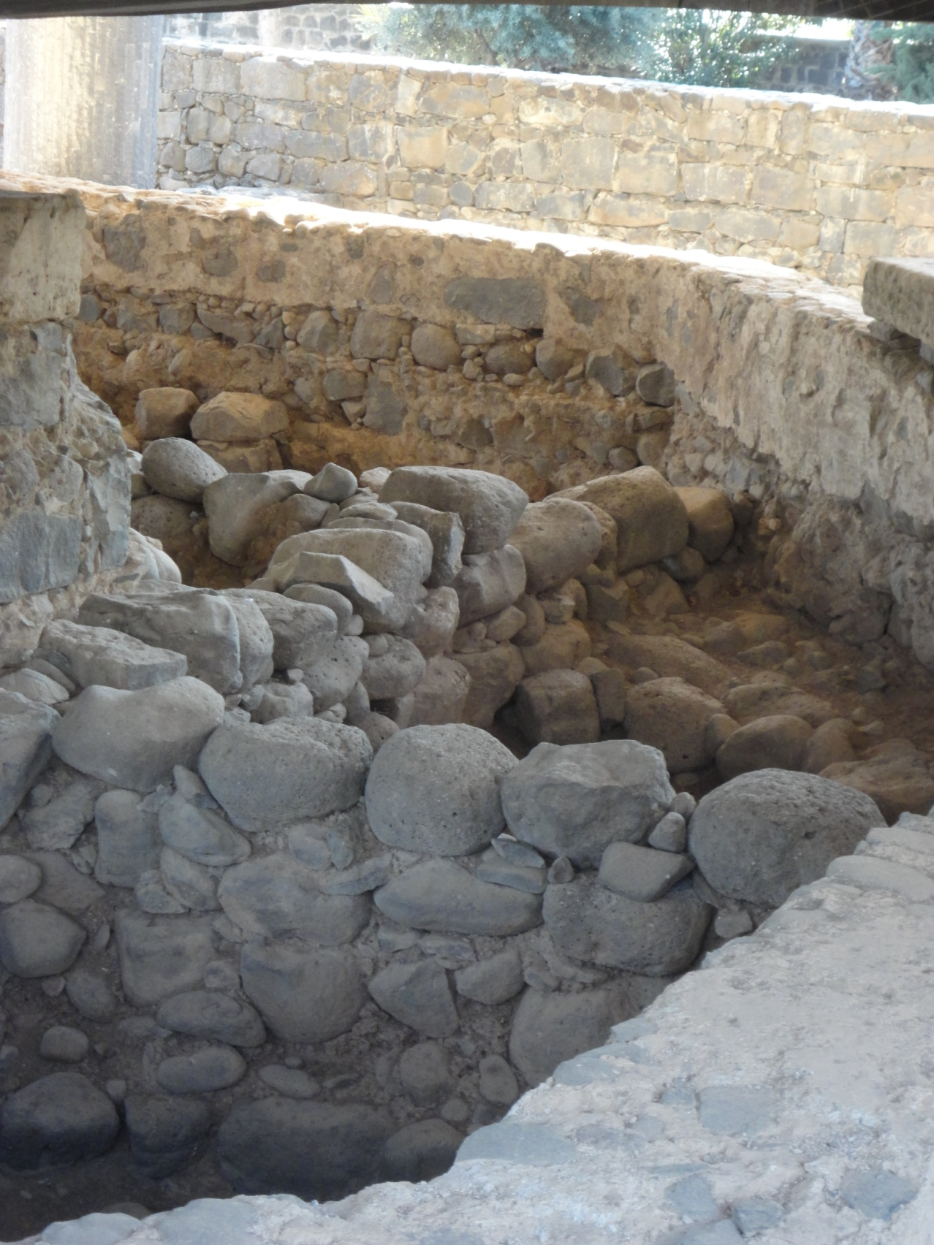
And when Jesus entered Peter's house, he saw his mother-in-law lying sick with a fever. ¹⁵ He touched her hand, and the fever left her, and she rose and began to serve him. Matthew 8:14-15 Notice that Mark does not include this story…

Slide 7
⁴² "Whoever causes one of these little ones who believe in me to sin, it would be better for him if a great millstone were hung around his neck and he were thrown into the sea. Mark 9:42

Slide 8
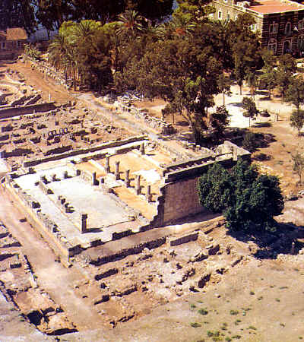
Aerial View of Capernaum Synagogue

Slide 9
And they went into Capernaum, and immediately on the Sabbath Jesus entered the synagogue and was teaching. Mark 1:21

