Slide 1
KINGS

Slide 2
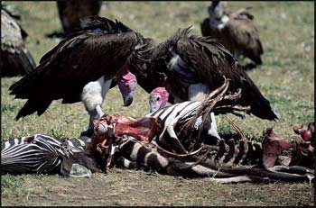
EXILE

Slide 3
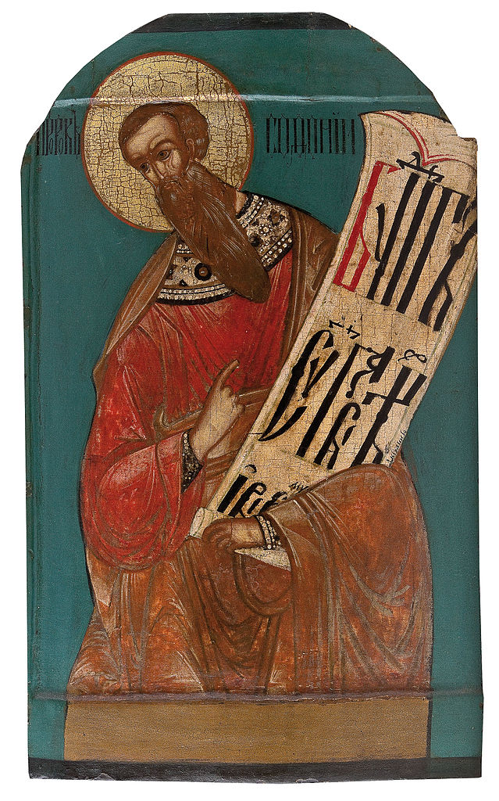
Zephaniah The Day of the Lord is nigh
North Russian Icon 17th Century

Slide 4
Faithful
Remnant

Slide 5
Habakkuk Have Faith

Slide 6
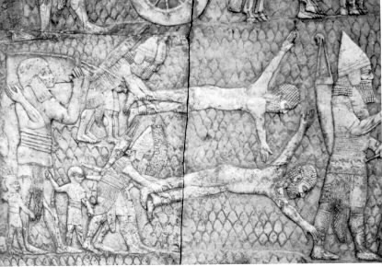
Relief depicting Assyrians flaying captives. Courtesy of Racheal McMullen

Slide 7
The challenge for the modern individual in Western Civilization is to understand the depth of despair and suffering the Israelites faced under the Assyrian reign. And even after trying to comprehend the environment in which Habakkuk lived, we must come to the conclusion that we simply cannot. The brutality of the Assyrians is simply astonishing. Their creative demonstration of torture and death exalts the evil that crouches at the door of a man’s heart. Great warrior kings ensured that their cruelty was engraved in stone monuments for all to remember. Such an inscription was preserved for us in the annals of King Assur-Nasir-Pal.
[1.90] who had revolted against me and whose skins I had stripped off, I made into a trophy: some in the middle of the pile I left to decay; some on the top
[1.91] of the pile on stakes I impaled; some by the side of the pile I placed in order on stakes; many within view of my land
[1.92] I flayed their skins on the walls I arranged; of the officers of the King’s officer, rebels, the limbs I cut off.
[1.116] their riches, oxen and sheep, I made plunder; much booty I burned with fire; many soldiers I captured alive;
[1.117] of some I chopped off the hands and feet; of others the noses and ears I cut off; of many soldiers I destroyed the eyes;
[1.118] one pile of bodies while yet alive, and one of heads I reared up on the heights within their town; their heads in the midst I hoisted…
Text Source: Annals of Assur-Nasir-Pal
Published work: "Babylonian and Assyrian Literature"
Translator: Rev. J. M. Rodwell, M.A.
Publisher: P. F. Collier & Son, New York
Copyright: Colonial Press, 1901

Slide 8
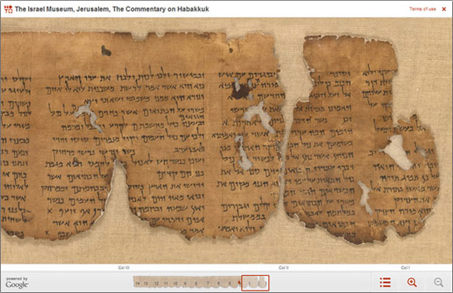
Commentary on Habakkuk Dead Sea Scrolls

