Slide 1
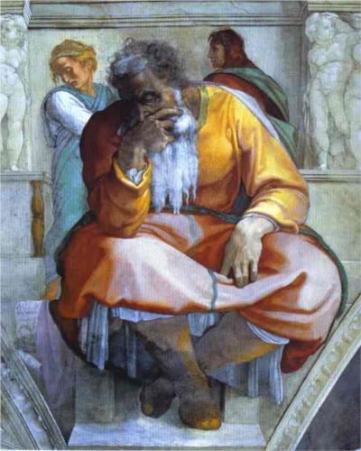
The Prophet Jeremiah Michelangelo, 1512
Jeremiah:
What do you know???

Slide 2
KINGS

Slide 3
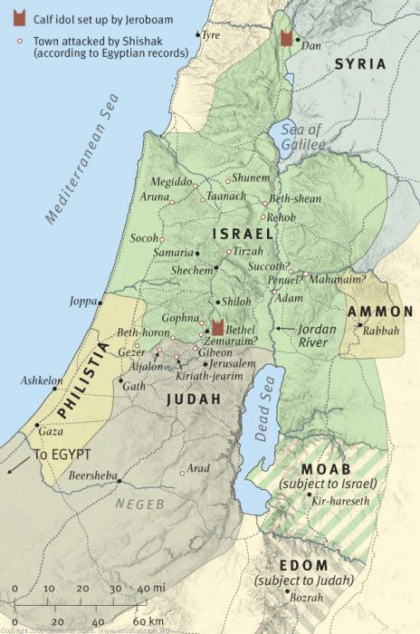
The Kingdom Divides

Slide 4
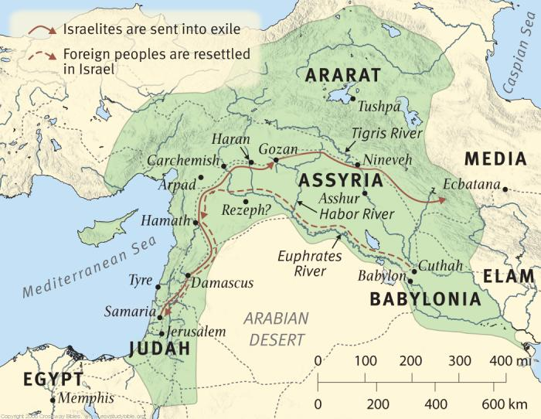
Assyrian Exile of Israel – 722/21 BC

Slide 5
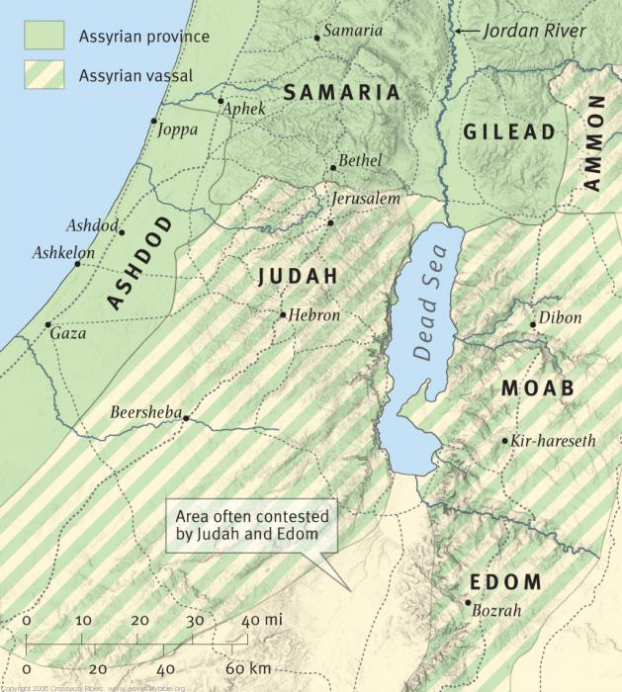
Judah after Assyrian Exile

Slide 6
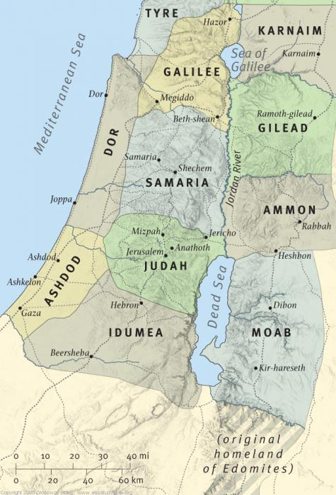
Israel and Judah at the time of Jeremiah

Slide 7
Jeremiah Worked for a Long Time BUT Chapters Do Not Follow Chronological Flow
Dates
Under Josiah (627–609 b.c.)
Under Jehoahaz (609) and Jehoiakim (609–597)
Under Jehoiachin (597) and Zedekiah (597–586)
After the Fall of Jerusalem (586)

Slide 8
Jeremiah 31 and the New Covenant
“a subjective situation of covenant reality rather than an objective development in covenant administration.” Collins
“A new situation in which the people embrace the covenant from the heart” Collins
Basic Covenant Principles Endure

Slide 9
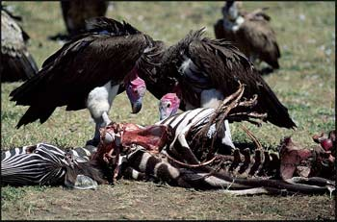
EXILE

Slide 10
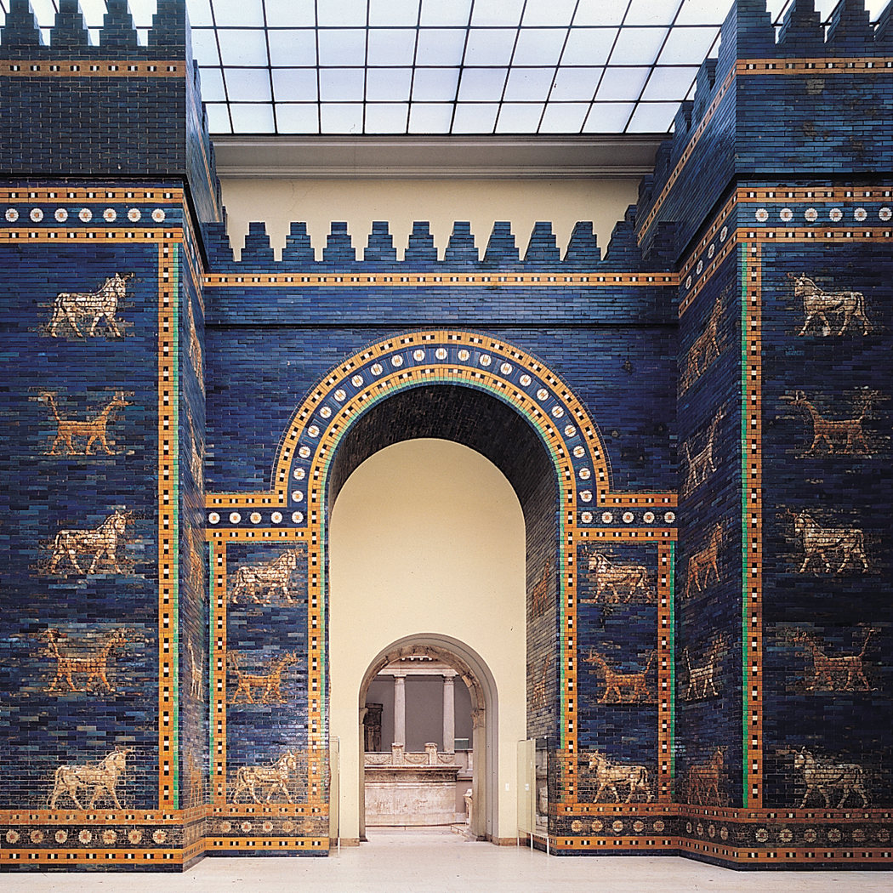
Babylon Rises to Power Ishtar Gate Babylon, Iraq 575 BC

Slide 11
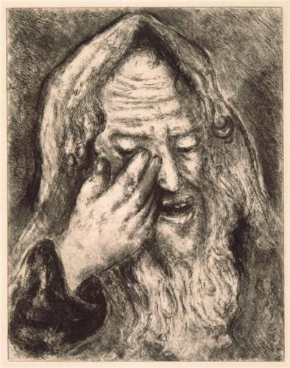
Lamentations: Developing Emotional Health
Lamentations of Jeremiah Marc Chagall, 1956

Slide 12
4 P’s Exercise Describe them at creation and at the time of Jeremiah.
People:
Presence:
Place:
Purpose:

