Slide 1
Augustine, On the Catechising of the Uninstructed, trans. Rev. Salmond
The narration is full when each person is catechised in the first instance from what is written in the text, "In the beginning God created the heaven and the earth,"⁴ on to the present times of the Church. This does not imply, however, either that we ought to repeat by memory the entire Pentateuch, and the entire Books of Judges, and Kings, and Esdras,⁵ and the entire Gospel and Acts of the Apostles, if we have learned all these word for word; or that we should put all the matters which are contained in these volumes into our own words, and in that manner unfold and expound them as a whole. For neither does the time admit of that, nor does any necessity demand it. But what we ought to do is, to give a comprehensive statement of all things, summarily and generally, so that certain of the more wonderful facts may be selected which are listened to with superior gratification, and which have been ranked so remarkably among the exact turning-points (of the history);⁶ …But as for all other details, these should be passed over rapidly, and thus far introduced and woven into the narrative.

Slide 2
Outline of Numbers

Slide 3
Biblical Archaeology News -- February 27, 2004
While excavating a burial tomb near Jerusalem in 1979, Gabriel Barkay uncovered the oldest known copy of Old Testament scripture. The priestly blessing, recorded in Numbers 6:24-26, was discovered on two small silver scrolls dated to the 7th century B.C. This was a discovery of utmost importance," said Barkay, professor of archaeology at Bar Ilan University near Tel Aviv. These verses pre-date the famous Dead Sea Scrolls by approximately four centuries. They are the only biblical verses we have from the time of the First Temple period.

Slide 4
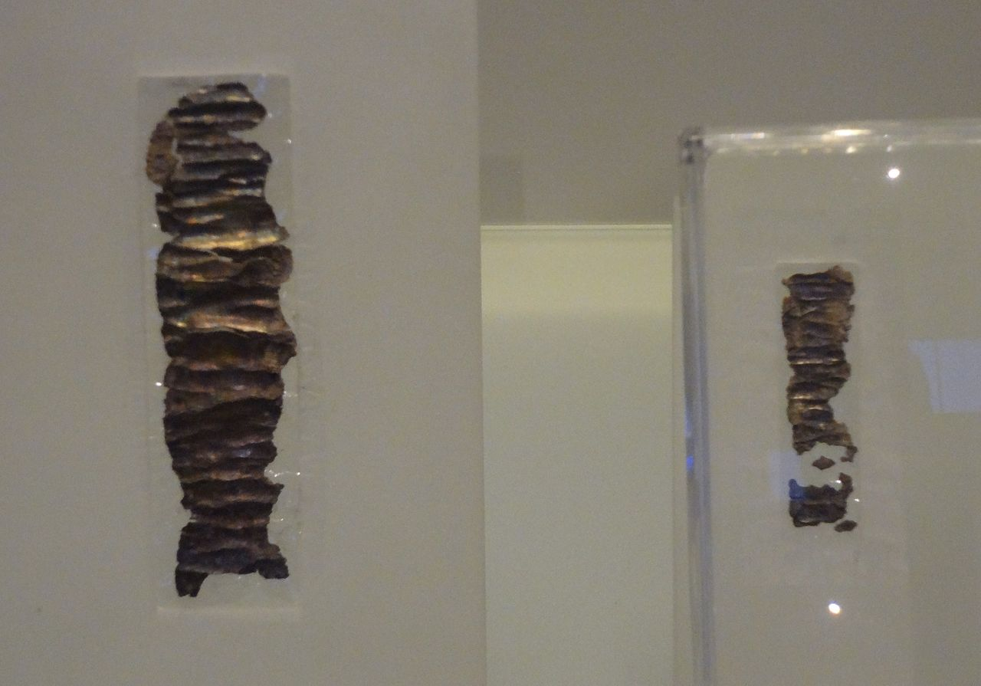
The Silver Scrolls: Numbers 6:24-26

Slide 5
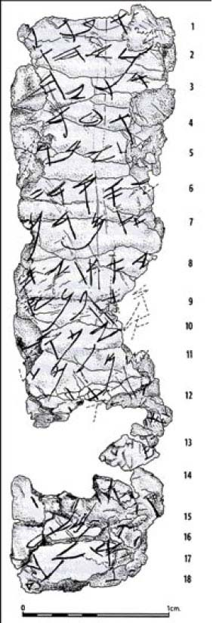

Slide 6
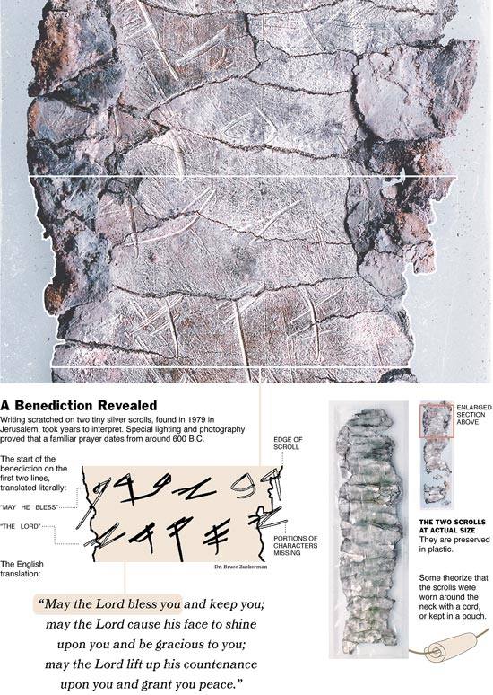

Slide 8
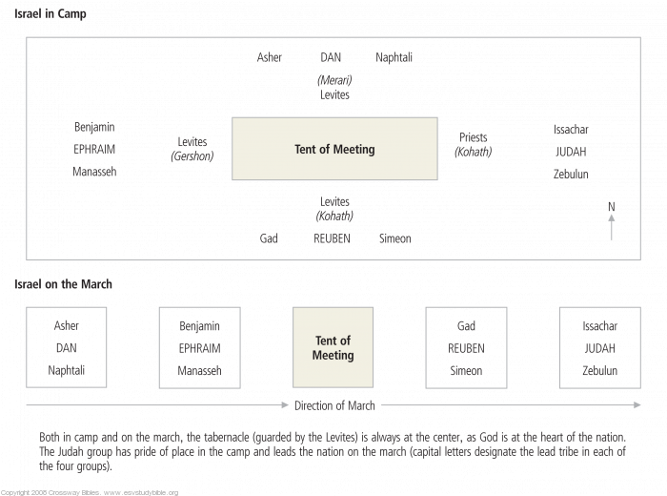
Israel in Camp and on the March

Slide 9
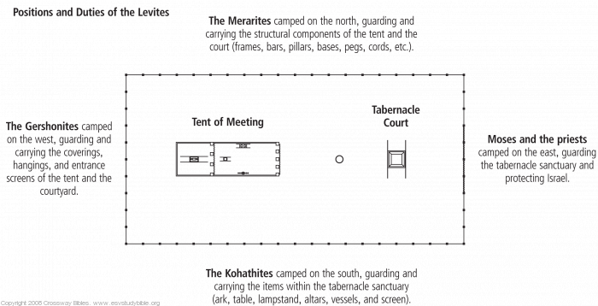
Positions and Duties of the Levites

Slide 10
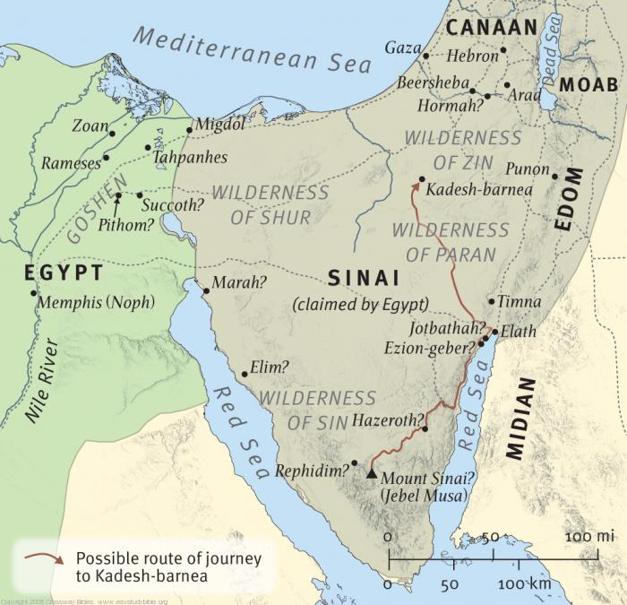
Journeys in the Wilderness

Slide 11
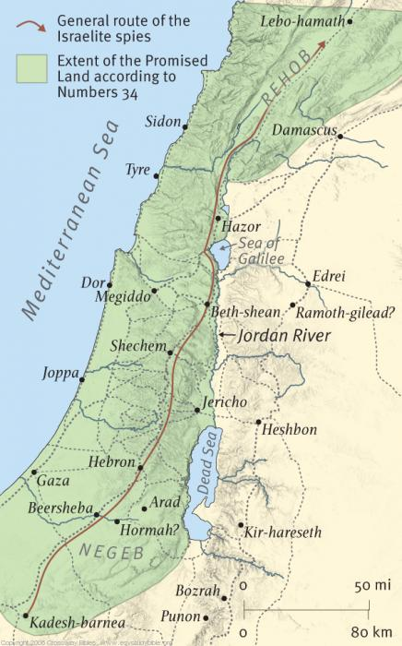
The Journey of the Spies

Slide 12
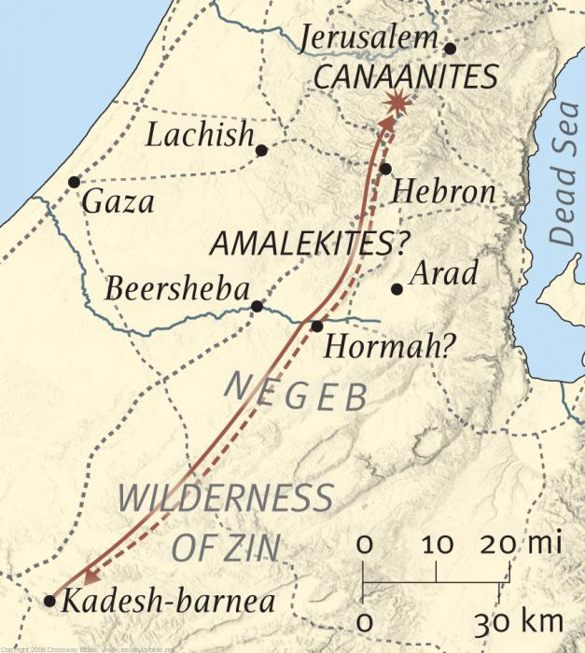
The Failed Entry into Canaan

Slide 13
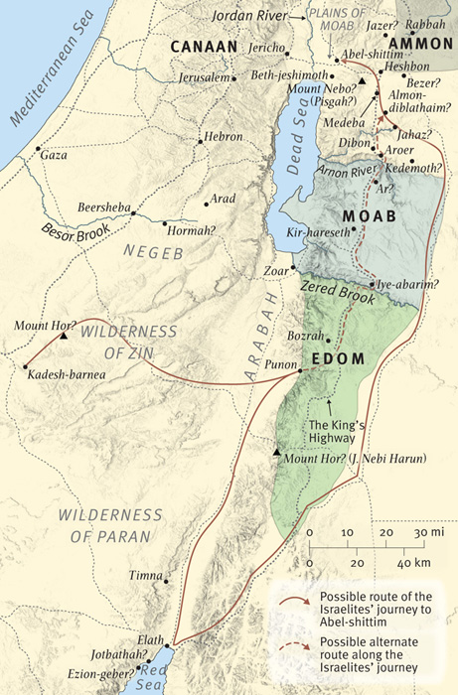
The Journey to Canaan

Slide 14
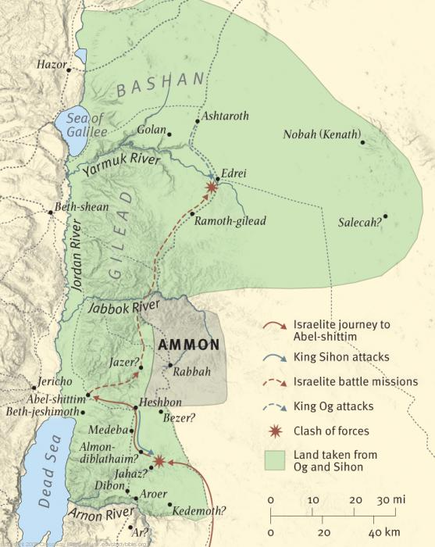
Israel Defeats Og and Sihon

Slide 15
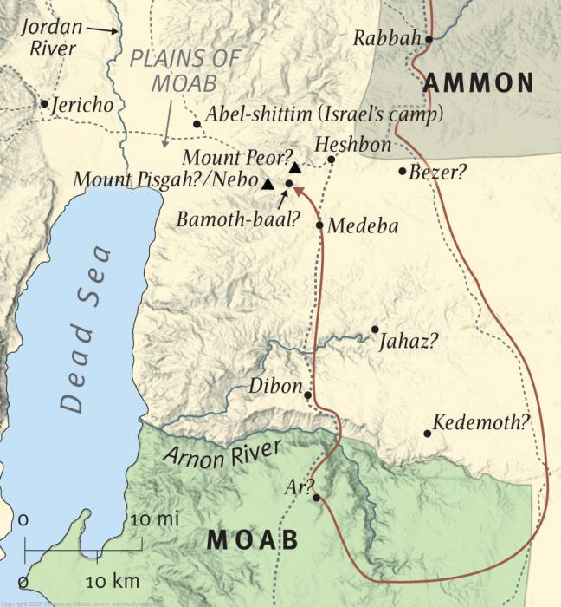
Balaam Blesses Israel

Slide 16
