Slide 1
C.A.S.K.E.T. E.M.P.T.Y.
Expectations
Messiah
Pentecost
Teaching
Yet-To-Come

Slide 2
EXPECTATIONS - The Intertestamental Period
OT
Between the Testaments
NT

Slide 3
Why does the Intertestamental Period Matter???
God’s Promises Fulfilled
Ex. Book of Daniel
History of Our People
Background of New Testament Writings
Samaritans
Pharisees
Saduccees
Tax Collectors and Zealots
Adoption
Salvation
Epicureans and Stoics
ETC., ETC., ETC.

Slide 4
Major Periods within Second Temple Judaism Second Temple Judaism developed as political authority changed hands from the Persians to the Greeks, to the Jewish Hasmoneans, and finally to the Romans.
539–331 b.c. | 331–164 b.c. | 164–63 b.c. | 63 b.c.–a.d. 70
The Persian Period | The Hellenistic Period Ptolemaic (Egyptian) Period (320–198) Seleucid (Syrian) Period (198–164) | The Hasmonean (Maccabean) Period | The Roman Period

Slide 5
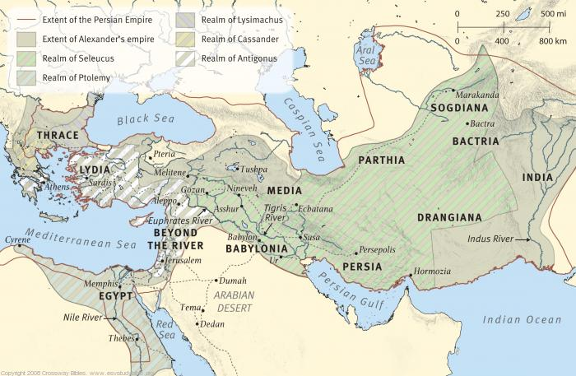
The Persian and Greek Empires

Slide 6
Chapter 2 | Chapter 7 | Chapter 8 | Interpretation
Head of Gold | Lion |  | Babylon deported Judah’s king in 605
Chest and Arms of Silver | Bear | Ram | Medo-Persian Empire defeated Babylon in 539 BC
Belly and Thighs of Bronze | Leopard | Goat (North/South in chapter 11) | Greece defeats Persians in 331 BC Prolemies and Seleucids
Legs of Iron | Terrifying Beast |  | Rome assimilated former Greek holdings
Rock Against Feet of Clay | Son of Man |  | Kingdom of God

Slide 7
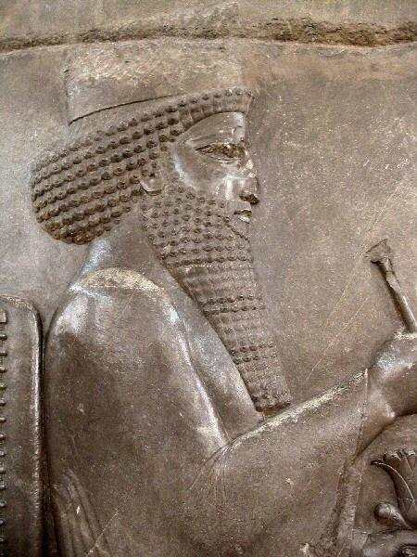
The Persian Post-Exilic Period 539-332 B.C.
Aramaic
Possibly synagogue (no temple or sacrifice)
Book of Daniel
Chest and Arms of Silver
Bear
Ram

Slide 8
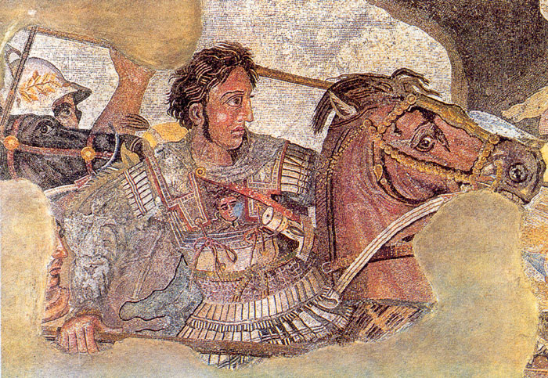
The Hellenistic Period 332 – 63 B.C.
Alexander the Great of Macedon (356 – 323)
Aristotle was his tutor
Cutting the Gordian Knot
Defeated Persian Empire
Book of Daniel
Belt and Thighs of Bronze
Leopard
Goat

Slide 9
The Greek Empire

Slide 10
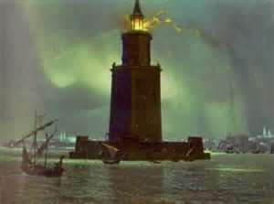
The Hellenistic Period 332 – 63 B.C.
Ptolemaic (Egypt) 320 - 198 B.C.
Dynasty began in 323
Alexander’s General Ptolemy I Soter (savior)
Alexandria (capital)
Judah under their rule till 198 B.C.
Ptolemy I Soter (savior)
Greek translation of the Hebrew Scriptures (Old Testament)
“Among Greek-speaking Jews this Bible became a standard text, serving both Judaism and the early church for centuries.” Burge, Cohick and Green

Slide 11
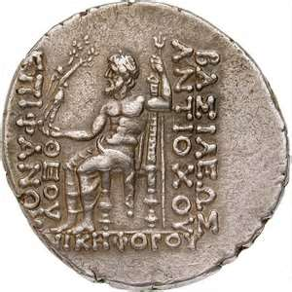
Hellenistic Period 332 – 63 B.C.
Seleucid (Syria) 198 - 167 B.C.
Dynasty began in 313
Alexander’s General Seleucus I Nicator (conqueror)
Antioch capital
Acts 11:19-20
Rule obtained from Ptolemies in 198
Antiochus IV Epiphanes (manifestation, i.e., the revealing of God on earth)
Sought worship
Frustrated with the Jewish people he “turned the temple over to the worship of Zeus and for three years pigs were sacrificed by Greeks on Israel’s holy altar.” Burge, Cohick, Green

Slide 12
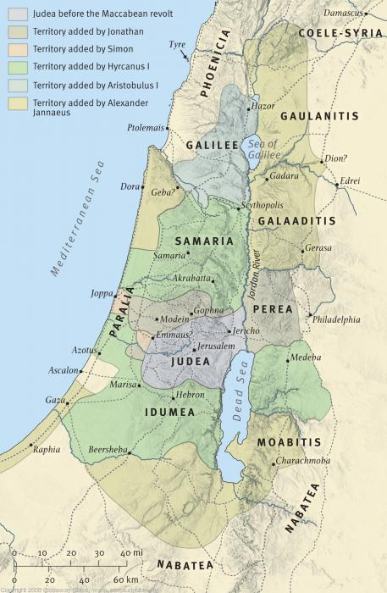
Israel Under the Maccabees

Slide 13
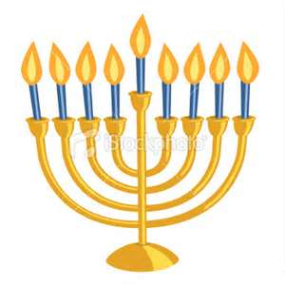
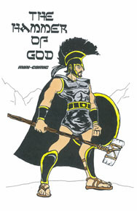
Maccabean War 167 – 141 B.C.
Hassidim (pious ones) passively revolted against Antiochus Epiphanes
Open Warfare
Matathias and his sons Judas, Simon and Jonathan
Launched guerrilla campaign to expel Greeks from the land
Matathias killed so Judas led war gaining the nickname “Maccabeus” (hammer)
164 Judas gained the temple precincts and cleansed th sanctuary, inaugurating the feast we know as Hanukkah also referred to as the “festival of lights”

Slide 14
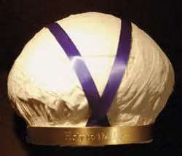
The Hasmonean Dynasty 141 – 63 B.C.
The family of Mattathias and heirs
In a generation Judaism found itself torn in three ways:
Hellenized Jews
Hasmoneans had power in Jerusalem
The Saduccees in the temple
AND…
High Priestly Turban represents the Sadduccees

Slide 15
The Hasmonean Dynasty 141 – 63 B.C.
Hasidim (pious ones) who called for religious purity and warned of the corruptive dangers of power
The Pharisees: lay movement
Synagogues
Precision in study and application
of Scripture
Zealots: radical religious sect seeking to overthrow Roman rule through violence. (Luke 6:15)

Slide 16
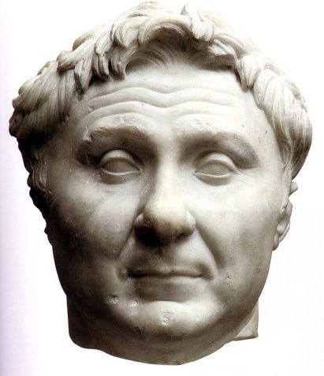
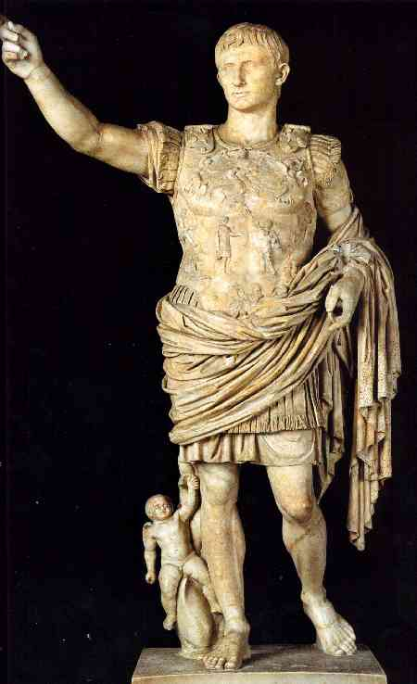
The Roman Period begins 63 B.C.
Pompey’s Conquest (63 B.C.)
Freed the Decapolis (League of Ten Cities) region promising they would never have to live under Jewish rule again
Mark 5:1-20
When Jesus entered he went into a strictly Greek world, hence the presence of pigs
Conquered Jerusalem and entered Most Holy Place
Book of Daniel
Legs of Iron
Terrifying Beast
First Roman Emperor Caesar Augustus
Coins have Latin inscription DIVI FILIUS “of the divine one, the son.”

Slide 17
Roman Emperors (31 b.c.–a.d. 68)
Augustus | 31 b.c.–a.d. 14
Tiberius | a.d. 14–37
Gaius Caligula | a.d. 37–41
Claudius | a.d. 41–54
Nero | a.d. 54–68

