Slide 2
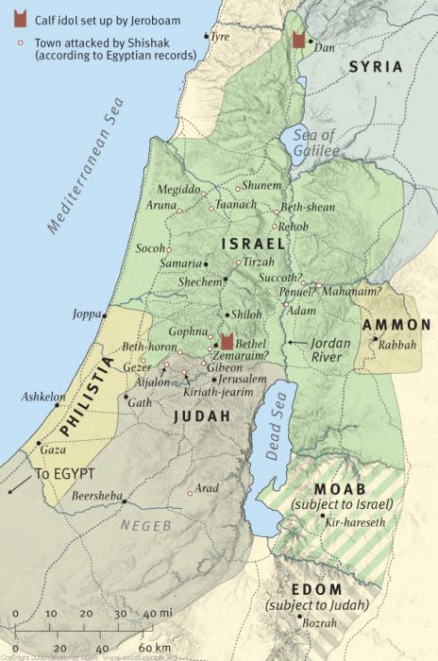
The Kingdom Divides

Slide 4
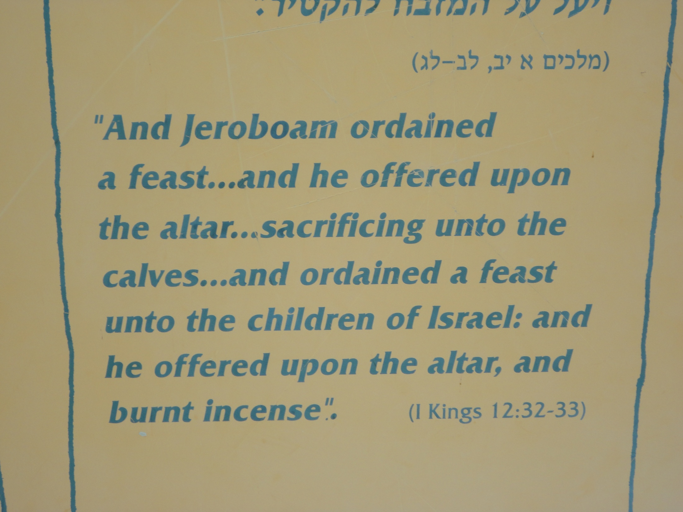

Slide 6
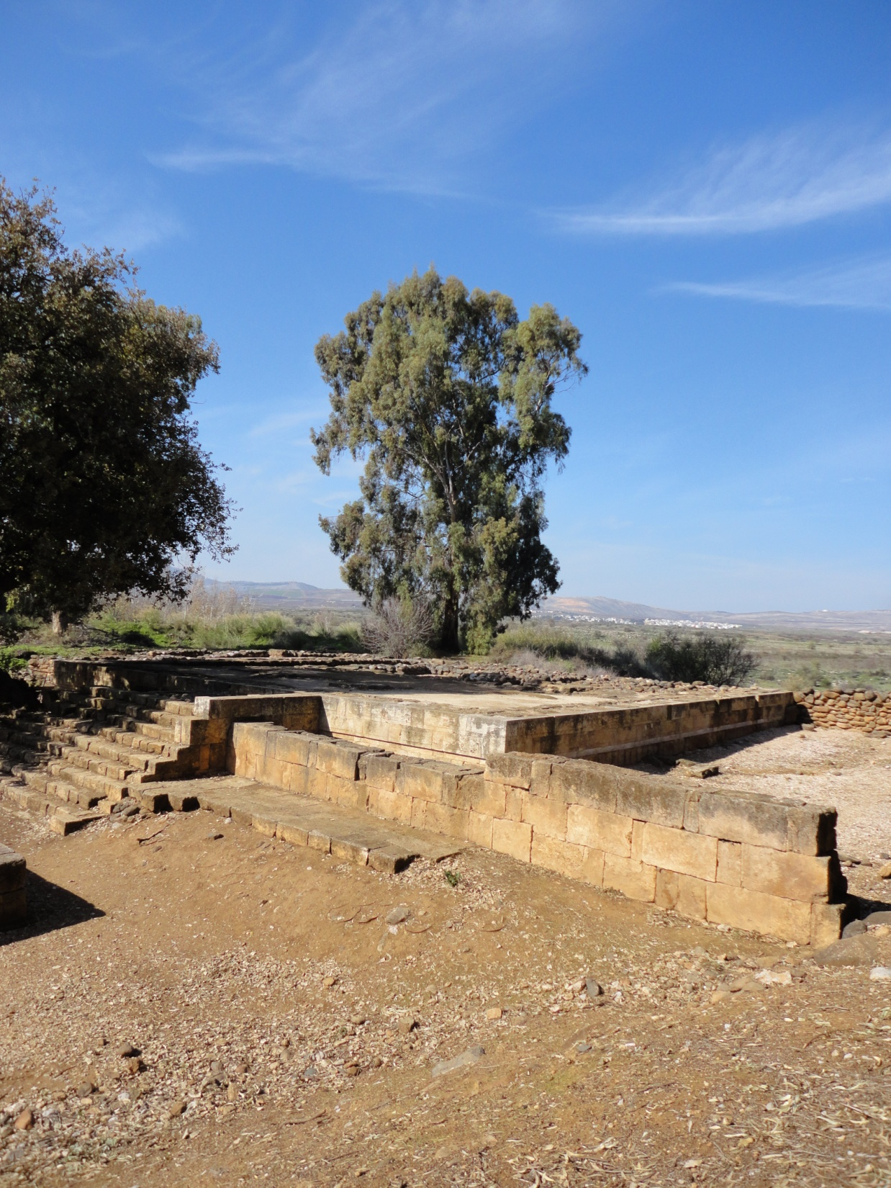

Slide 7
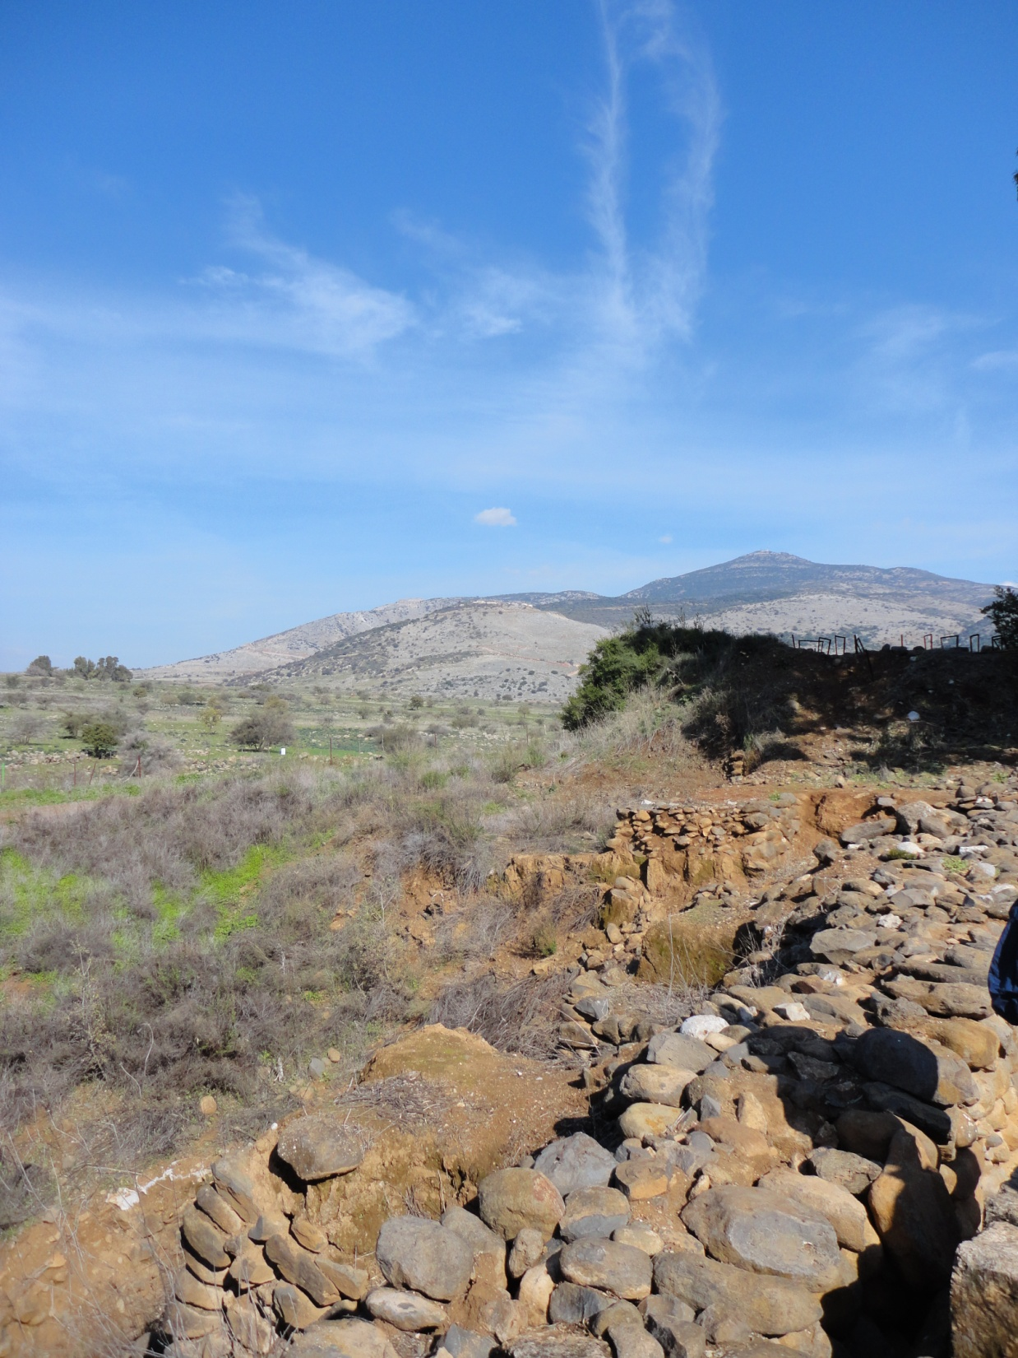

Slide 8
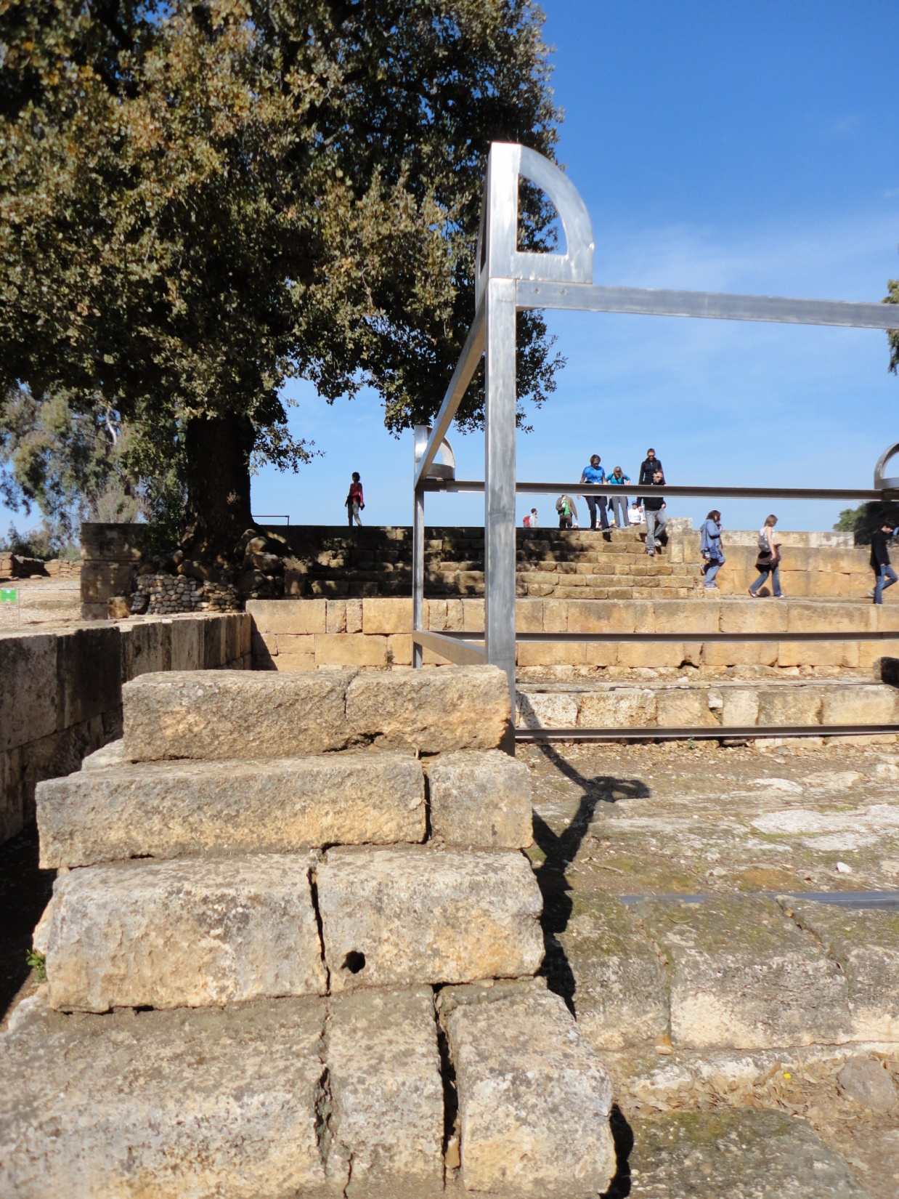

Slide 9
8th Century Messengers to Northern Kingdom
Jonah, Amos, Hosea

Slide 10
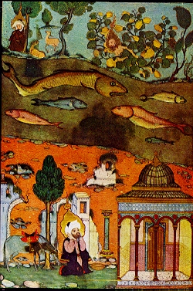

Slide 11
Jonah – The Wrong Way Prophet

Slide 13
Israel Travel Poster – 1954 by John David

Slide 14
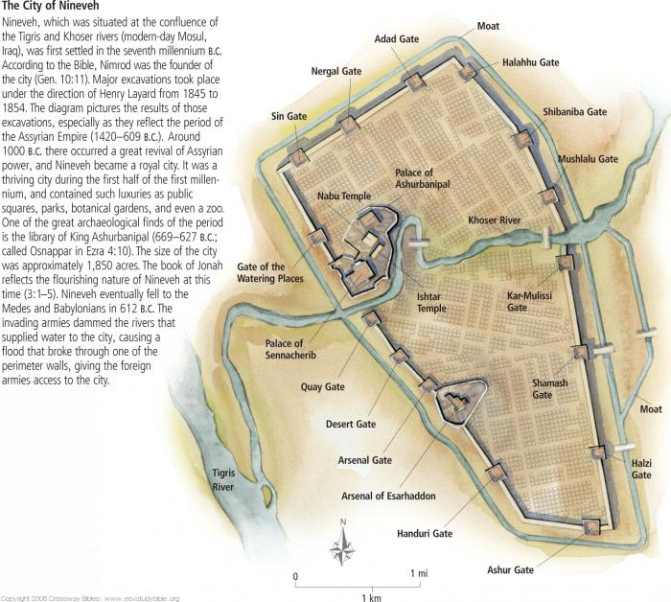

Slide 15
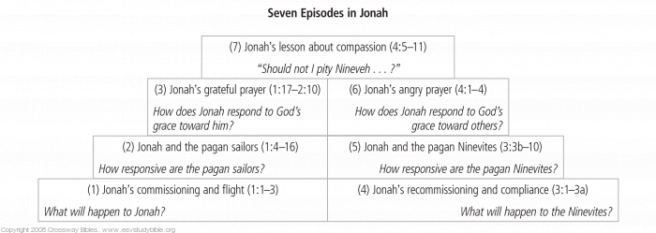

Slide 16
Amos Southern Farmer & Northern Prophet

Slide 17
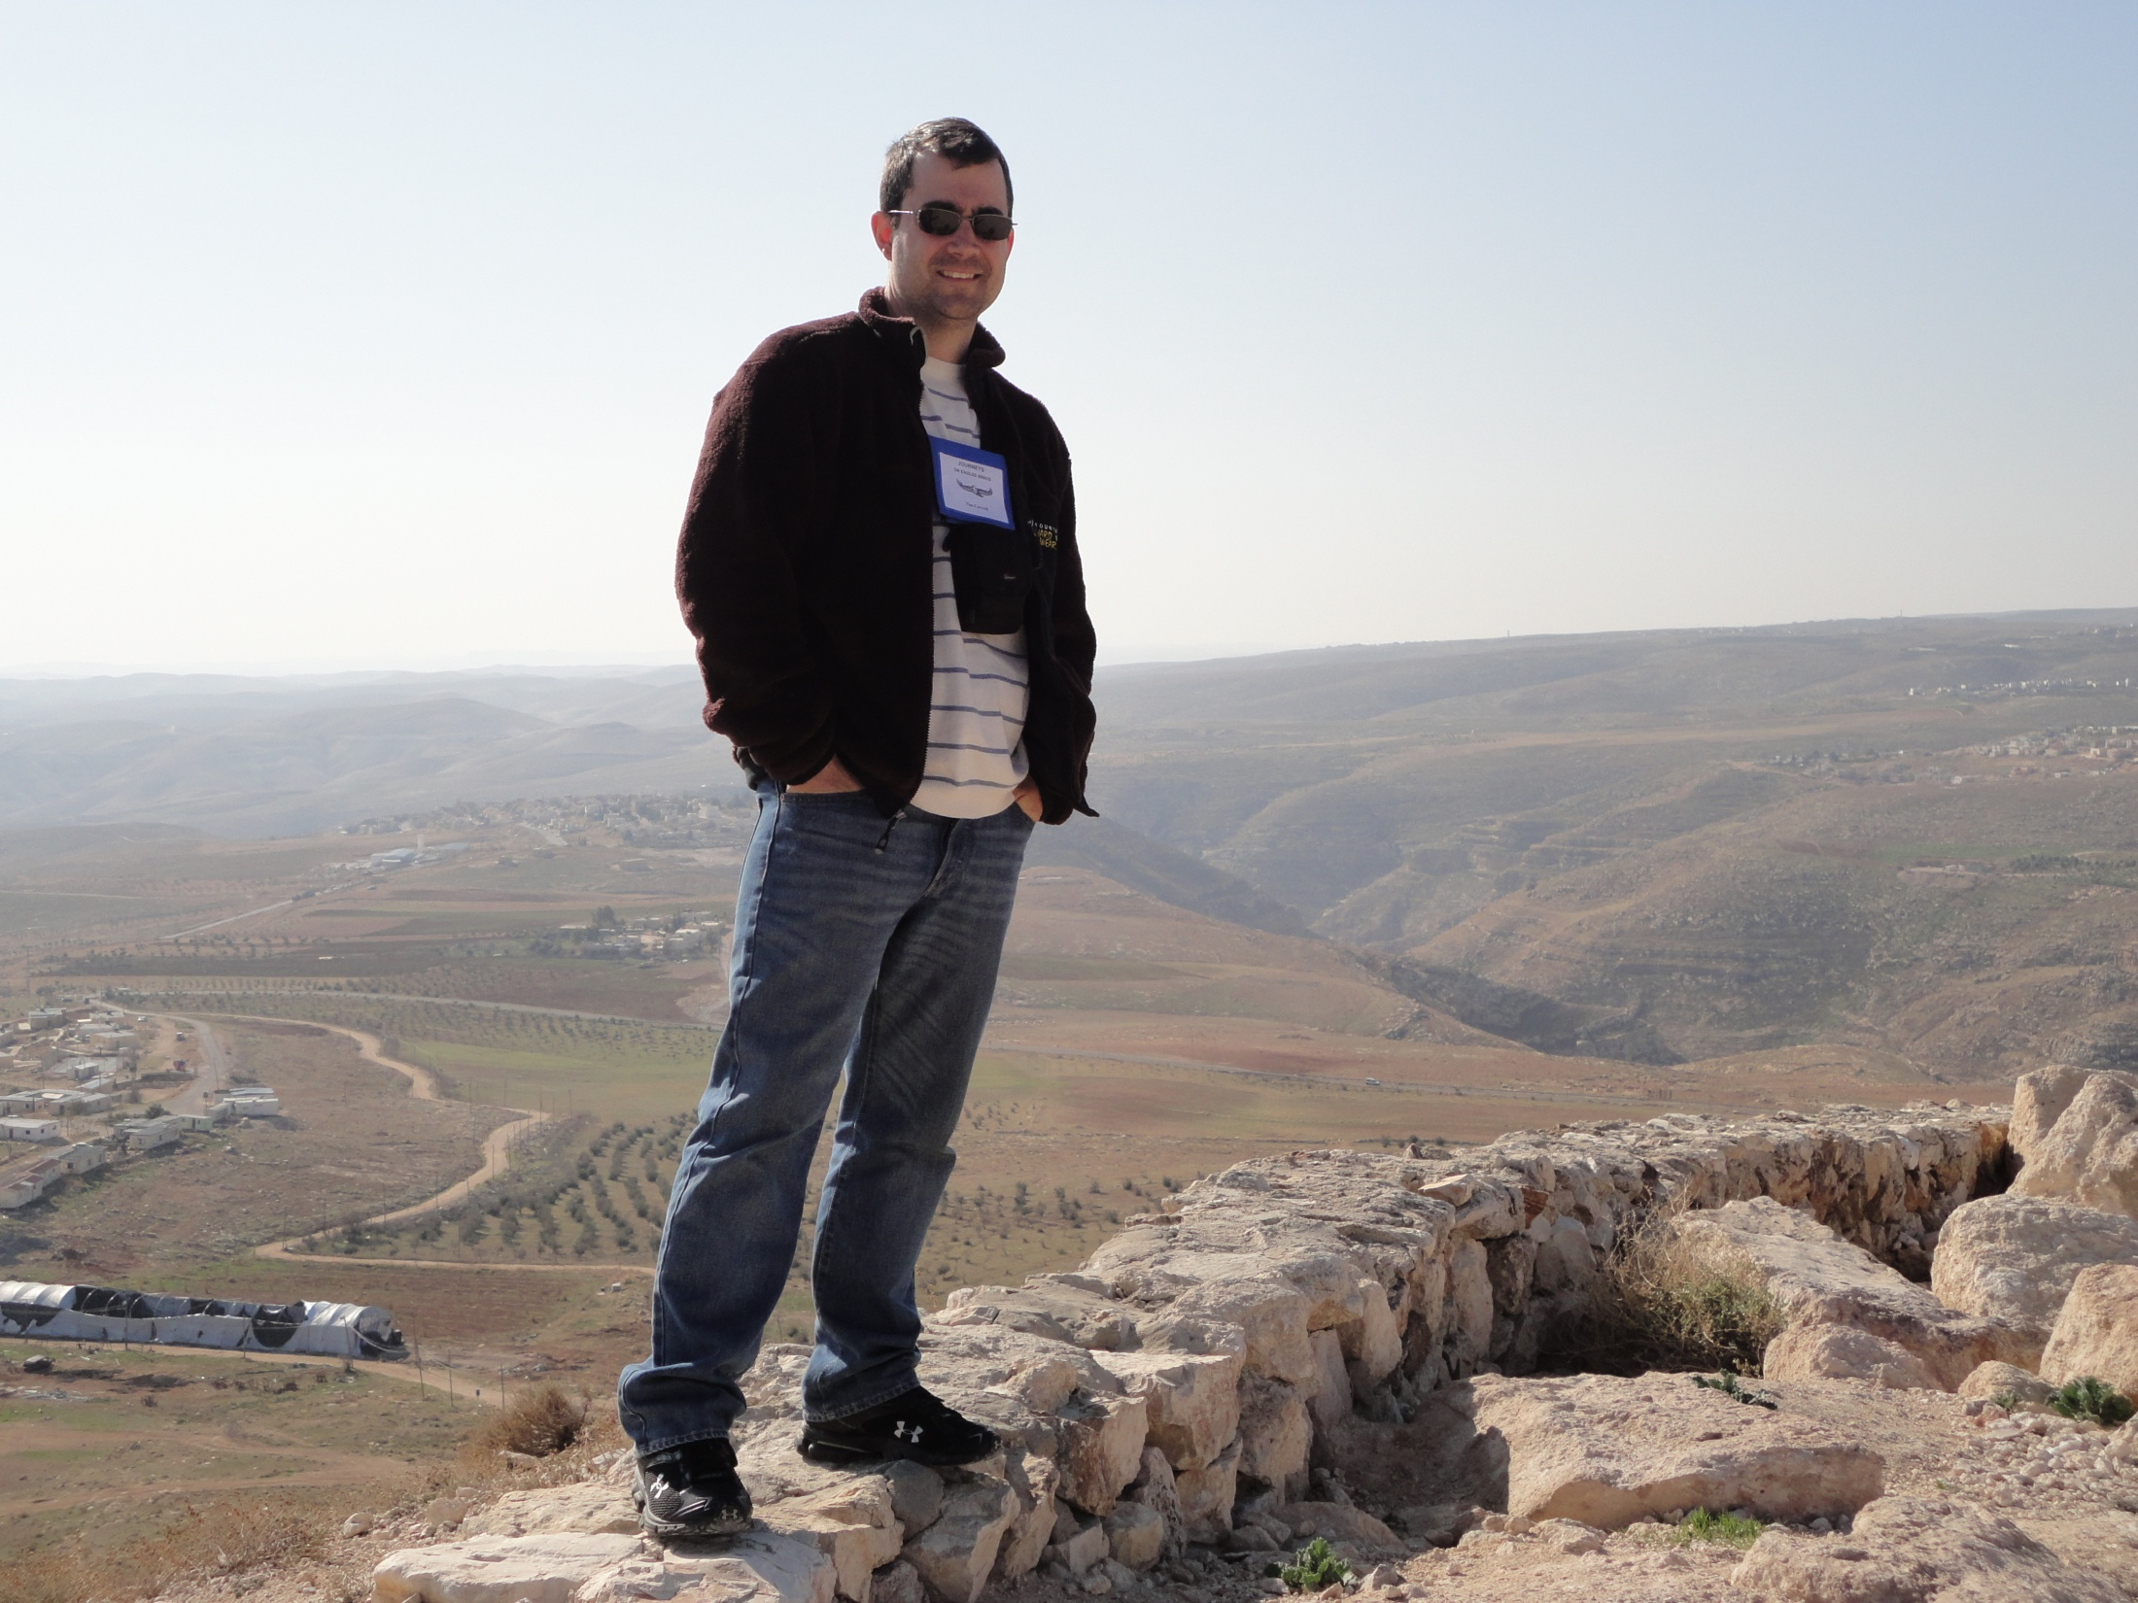

Slide 18
Serving God’s People in Christ’s Power

