Slide 1
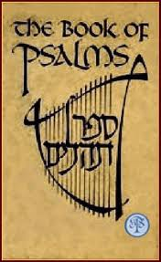

Slide 2
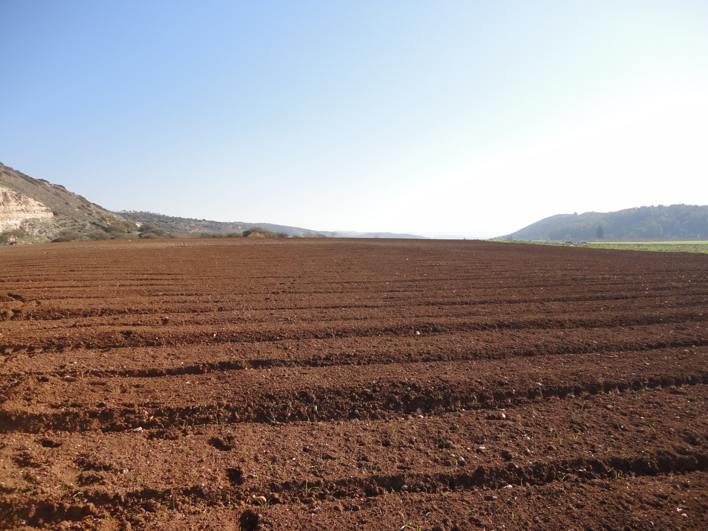

Slide 3
Modern Jerusalem

Slide 4
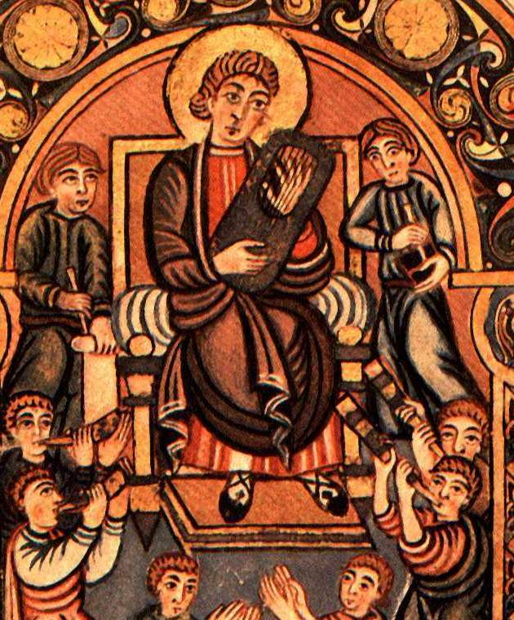
King David composing the Psalms. English circa 750

Slide 5
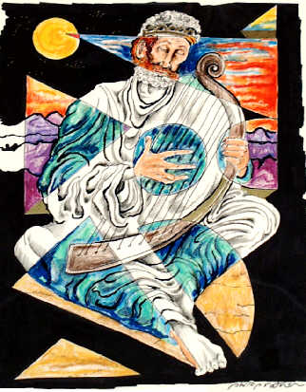
David the Psalmist by Philip Ratner

Slide 8
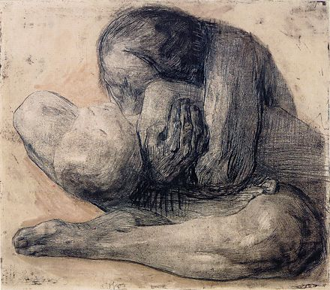
Psalms of Personal Lament Kathe Kollwitz – Woman with Dead Child

Slide 9
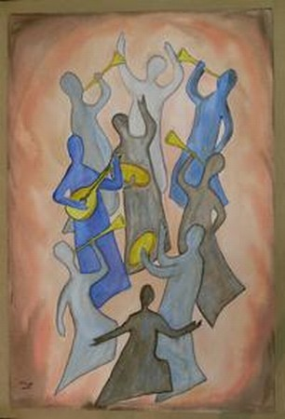
Psalms of Praise

Slide 10
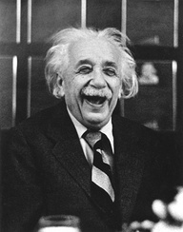
Example of Admiration

Slide 11
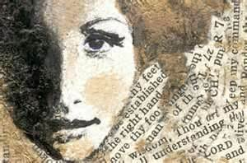
Psalms of Wisdom

Slide 12
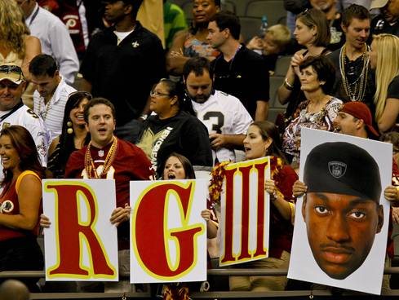
Example of Confidence

Slide 13
Imprecatory or Curse Psalms

Slide 14
Psalms of Ascent

Slide 15
GOD
Representative

